Slide 1
Frederick Moore
How Many Miles to Babylon by Jennifer Johnston.
http://www.youtube.com/watch?v=M7hXVN5pfms&feature=endscreen&NR=1

Slide 2
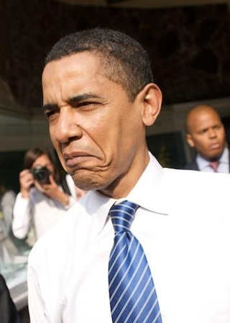
Frederick is an upper class citizen who is trapped in a loveless marriage with a wife who treats him with contempt. He is kind, well meaning man, but he is also weak and lacks the emotional vocabulary to express his love.

Slide 3
Weak
Frederick never stands up to his wife.
Gets rid of piano teacher on Alicia's behalf.
Whenever Alicia insults Frederick does not stand up to her.’ Ineffective and old’ .
When Frederick speaks there is a since that he is parroting her words.
Alicia decides to send Alec to Europe, Frederick says ‘ We think its time you stretched your wings abit.’

Slide 4
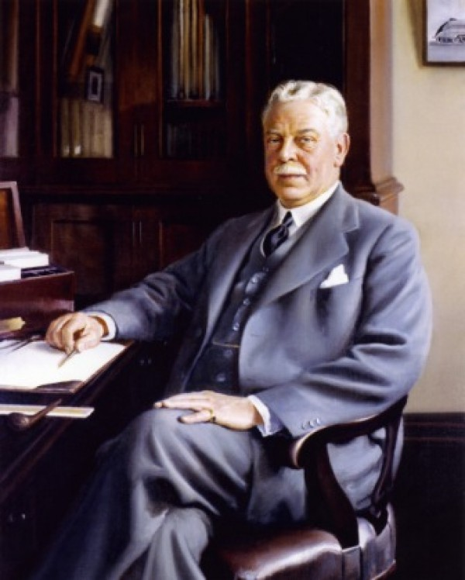
Well Meaning
- Frederick offers Alec the opportunity to go to school ‘How would you like to go to school my boy’.
- There are moments through out the novel where Frederick tells Alec ‘ Do as your Mother says’. This may be Frederick trying to prevent Alec getting in trouble with Alicia.
- Sadly, Fredericks weak submissive nature means his attempts are crushed by Alicia's domineering and manipulative way.

Slide 5
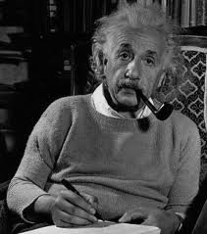
Lonely & Unhappy
- Alicia despises Frederick and tries her upmost to ensure he and Alec posses no bond, this leaves Frederick very lonely.
- He basis himself with ‘ Farm matters ‘. And his spare time is spent ‘ working at his pipe ‘.

Slide 6
When Frederick has the luxury of having Alec’s company he enjoys it ‘ All in all he seemed glad of my company but in the same way that a man on a desert island must be glad to see and talk to his shadow from time to time ‘.
The only time we see Frederick happy is when he thinks of the taught of Alicia facing the prospects of ‘ Wrinkled fingers ‘ and ‘ No one left to die for her ‘ gives him a grim pleasure.

Slide 7
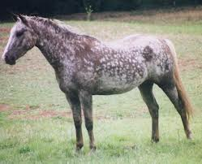
Finds it difficult to express his Emotions
Because of his social position and up bringing, Frederick is not comfortable when it comes to emotions.
He finds it difficult to express his love for Alec, he resorts in buying him an expensive, beautiful mare.

Slide 8
When Alicia decides to send Alec to war, we finally see Frederick stand up to her ,
‘ Everything that you have ever wanted, everything Alicia remember that, ponder deeply before you take away my son. No is what I say, No. ‘
We can see he does love his son as he stands up to her.
When Alicia enlists Alec to departure for the front line, Frederick does his best to hide his heartbreak at the thought of his son leaving and confines his conversation to rather matter-of-fact topics such as has he money and what will he do with Alec's mare in his absence.
However, his hands are shaking as he picks up the newspaper and it is obvious that he is wrestling with some strong emotion.

Slide 9
Frederick gives Alec a gold watch, calling it a traditional gesture as he acknowledges that ‘ sentimentality ‘‘doesn't suit either of them .
Alec and his father part ways with minimum fuss but with clear love on both sides. This contrasts strongly with Alicia's theatrical, superficial behaviour in the drawing room moments later when she gleefully says goodbye to her son.

Slide 10
Final Impression
Frederick Moore is a kind, well-meaning, weak man.
Locked in an unhappy marriage.
Loves his son, but does not have the emotional vocabulary to express his love.
Frederick’s life is lonely, but there is a glimmer of hope and happiness when Alec starts to work with him on estate business, but Alicia cruelly puts a stop to this by sending him off to war.
Alec remarks that the news of his impeding death may kill his father, but he also notes that Frederick ‘ May be better off dead’.
Such a sentiment may seem heartless until we see the lonely misery that is life in the Moore household.

Slide 11
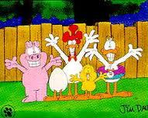
Created by John & Laoisa.
http://www.youtube.com/watch?v=0sdP-Q32Vao

