Slide 1
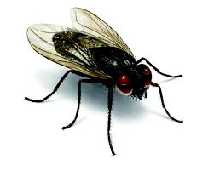
I heard a Fly buzz – when I died
By EmiIy Dickinson

Slide 2
Emily Dickinson - Bio
Born in Boston in 1830
She was born into a wealthy family
In her early 20’s, she loved socialising
In her 30’s, she became a reclusive
Her poetic style is unique (punctuation/capitals/dashes etc.)
Poetry reflects themes of death and mental suffering
Died aged 56 from a kidney disease in 1886

Slide 3
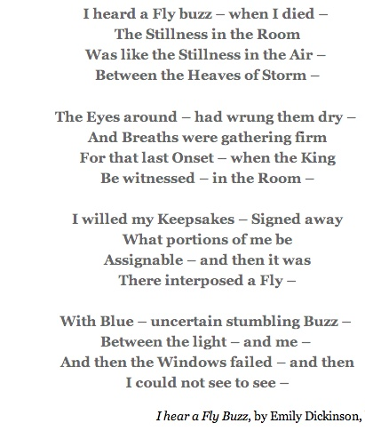
I heard a Fly buzz –when I died -

Slide 4
Stanza 1
She says that as she passed away, a fly was buzzing in the room: ‘ I heard a Fly buzz – when I died’.
The quietness of the room is compared to the stillness experienced at the centre of a storm.
As she suffered on her deathbed, the room was noisy but her final moments were filled with calmness.

Slide 5
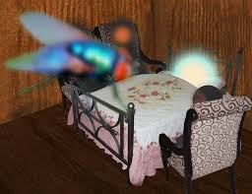
Stanza 2
The speakers loved ones were gathered around her. They had ‘wrung’ their hands dry from crying.
They held their breathes, waiting for the ‘last Onset’ or attack of the speakers illness when she would pass away.
Their loved ones are waiting for the ‘king’ (God) to come into the room at the moment of death.

Slide 6
Stanza 3
The speaker has signed her will ‘assigning’ her valued items to loved ones
But there is one part not ‘assignable’ a part she can’t give away, that is her immortal soul
As she begins to die, a fly appears positioning itself between her and the light. The fly interrupts all and there is little hope of an afterlife.

Slide 7
Stanza 4
The fly is in its ‘uncertain stumbling’ strips the speaker’s dignity of death
The window ‘failed’ to allow light into the room. The speaker’s vision was flooded with darkness as she died
As she passed away her sense of vision stopped working : ‘I could not see to see’. The room was filled with darkness
The positioning of the fly is puzzling.
Instead of hearing the fly, the speaker should be hearing the soothing words of her loved ones

Slide 8
Themes
Death
Mental and physical anguish
Darkness

