Slide 1
Poetic Devices and the Magic of Elizabeth Bishop

Slide 2
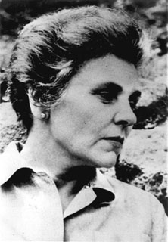
Elizabeth Bishop
1911 –1979

Slide 3
Characteristics of Bishops Work
Great attention to detail
Interest in nature
Empathy for creatures
Surprising imagery

Slide 4
Simile
A comparison of two subjects using like or as.
She’s as sweet as candy.
John sings like a flute.
Laura is as light as a feather.
Don is as slow as molasses in
January.

Slide 5
Metaphor
A comparison or analogy stated in such a way as to imply that one object is another one, figuratively speaking.
“She was a lone reed blowing in the wind.”
“She’s a brick house”
“He is a gentle giant.”

Slide 6
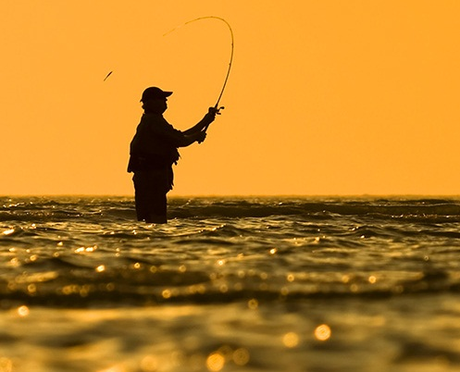
The Fish

Slide 7
Read the poem in your hardback copy now!!!
Initial Reactions?

Slide 8
Can you pick out any poetic devices that Bishop used?
Does any line in the poem stand out to you?

Slide 9
“Here and there his brown skin hung in strips like ancient wallpaper”

Slide 10
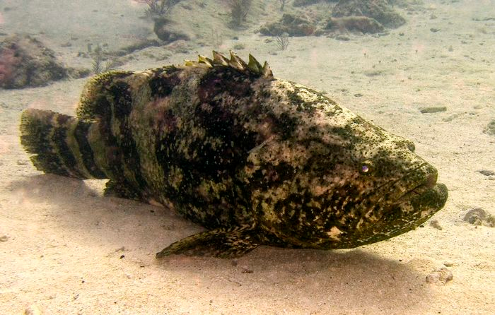
Old Caribbean Jew Fish – This is the type of fish that Bishop caught in Key West, Florida.
Peeling Brown Wallpaper

Slide 12
“I thought of the course white flesh
Packed in like feathers…and the pink swim-bladder
like a big peony.”

Slide 13
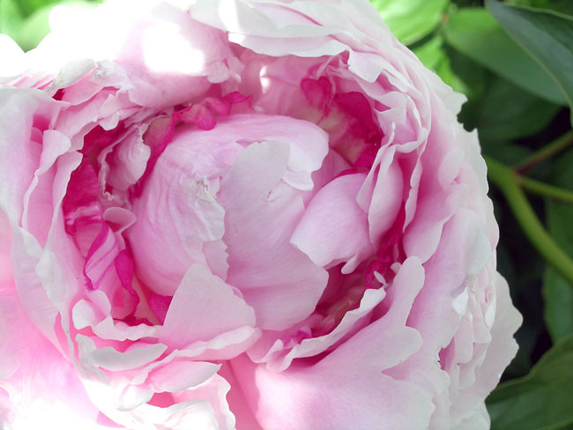

Slide 14
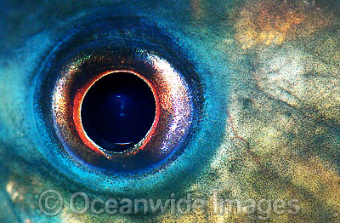
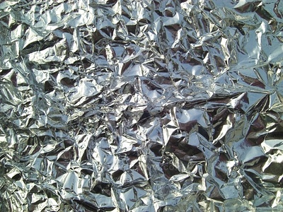
“I looked into his big eyes
which were far larger than mine
but shallower, and yellowed,
the irises backed and packed
with tarnished tinfoil
seen through the lenses
of old scratched isinglass.”

Slide 15
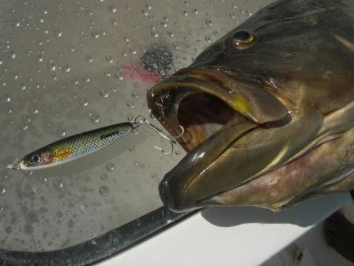
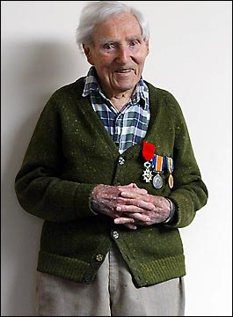
“He hung a grunting weight, battered and venerable and homely.”
-”It was more like the tipping of an object toward the light. I admired his sullen face, the mechanism of his jaw…
“Like medals with their ribbons frayed and wavering, a five-haired beard of wisdom trailing from his aching jaw.”

Slide 16
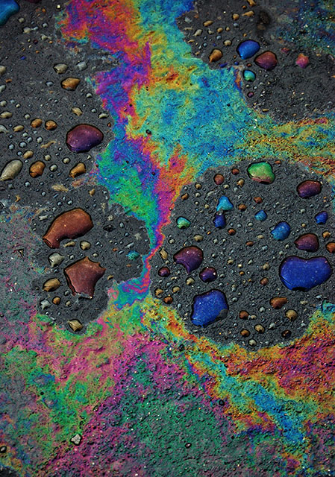
I stared and stared and victory filled up the little rented boat, from the pool of bilge where oil had spread a rainbow around the rusted engine to the bailer rusted orange, the sun-cracked thwarts, the oarlocks on their strings, the gunnels--until everything was rainbow, rainbow, rainbow! And I let the fish go.

Slide 17
Match That figure of Speech
The sea is …
2. As softly as …
3. On stumps and dead trees the charring…
4. For two weeks or more…
5. The beach…
A. Falling stars come to their ends at a point in the sky.
B. The trees hesitated; the little leaves waited…
C. ..hisses like fat
D. “all a case of knives”
F. Is like black velvet.

