Slide 1
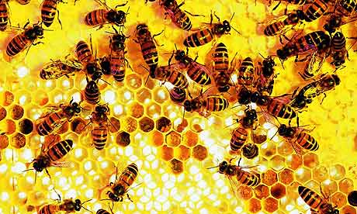
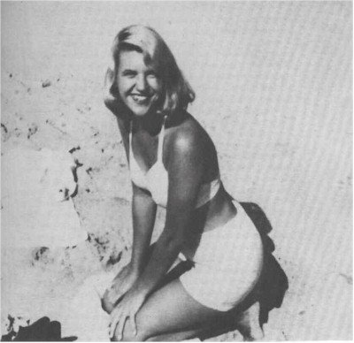
The Arrival of the Bee Box
The Arrival Of The Bee Box
By Sylvia Plath.
By
Sylvia Plath
Created by
Daniel Lambert

Slide 2
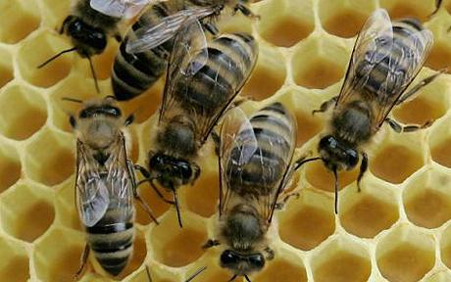
In this poem, Sylvia Plath expresses a desire to be in control. She feels she has to deal with a dangerous situation. At first she is not in control. She panics. She has a debate with herself and then she makes a calm decision.
On one level, Plath is simply recalling a personal incident. The story of the poem concerns a task with a bee box. In the first stanza she states that it looks like ‘square’, like a midget’s coffin, heavy and noisy.
In the second stanza, the bee box both frightens and attracts Plath. She stares in at the bees through a little wire grid.
In the third stanza, she regards the bees as angry slaves that seek release and revenge: ‘Black on black, angrily clambering’. Through the wire grid she sees darkness. She imagines the bees are like army divisions of blackness that she associates with ‘the swarmy feeling of African hands’.
In the fourth stanza, the buzzing noise puts her off releasing the bees. She fears their bee language and now regards them as an aggressive Roman mob. She describes their language as ‘unintelligible syllables’.
‘such a din in it’. The word ‘coffin’ suggests death. The overall description of the bee-box is strange and disturbing.
In the fifth stanza she sidesteps the problem: ‘I am not a Caesar’. She means she is not all-powerful. She also means that she doesn’t have to understand the bees’ ‘unintelligible syllables’, which she would have to if she were Caesar listening to a ‘Roman mob’.

Slide 3
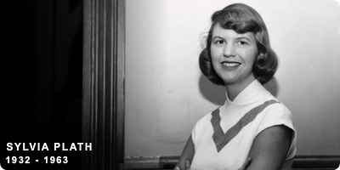
Themes
In this poem Sylvia Plath expresses a desire to be in control: ‘Tomorrow I will be sweet God’.
Sometimes there is a tone of horror: ‘the swarmy feeling of African hands… Black on black, angrily clambering’.
Sometimes the tone is empty and shows a lack of concern: ‘They can be sent back. They can die, I need feed them nothing’
Sometimes the tone appears to be pleased, calm and decisive: ‘Tomorrow I will be sweet God, I will set them free. The box is only temporary’.

Slide 4
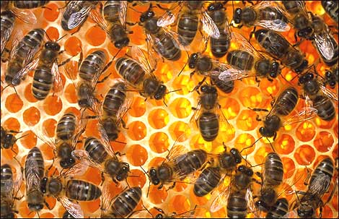
Imagery
In the first stanza, Plath simply states a fact with the image of the 'clean wood box'. Then she uses a simile in which she compares the box to a square chair: 'square as a chair'.
Plath uses three comparisons in stanzas three, four and five. She calls the bees black slaves, a Roman mob and maniacs. [If you wish to, you can refer to these comparisons as analogies. Analogies are parallel images.
There are three dramatic images of fear: ‘The box is locked, it is dangerous… Black on black, angrily clambering... It is the noise that appals me most of all’.

Slide 5
The end

