Slide 1
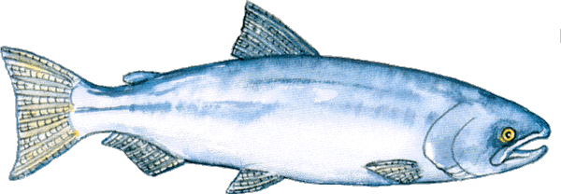
Mrs Shannon
CLICK HERE TO LISTEN TO THIS POEM

Slide 2
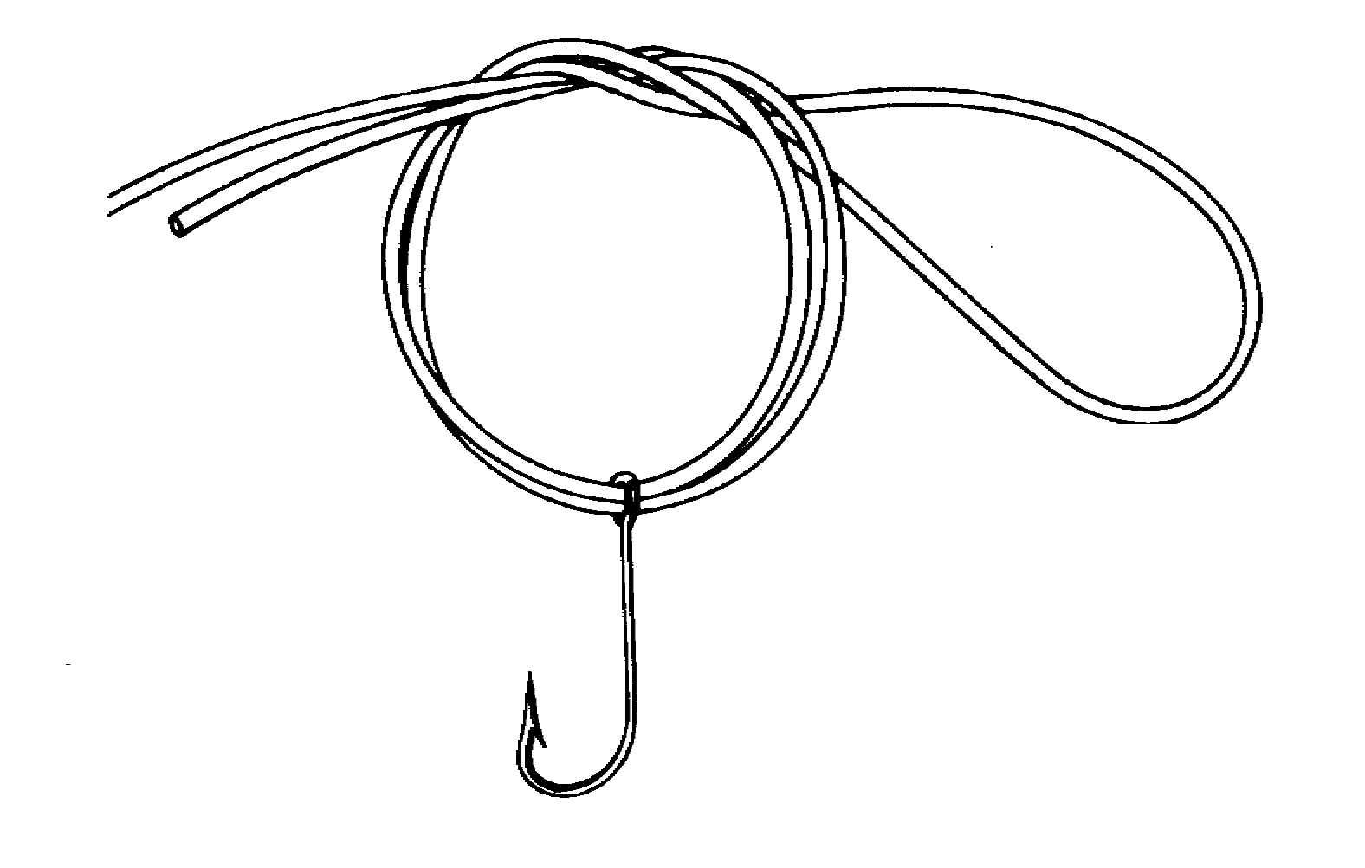
The poet has caught a ‘tremendous’ fish and she holds him ‘beside the boat/half out of the water’ so that she can observe him.
The fish is held by the hook that is caught ‘fast in a corner of his mouth’.
This adjective adds interest and excitement immediately
The word ‘fast’ adds to the dramatic quality of the opening lines.

Slide 3
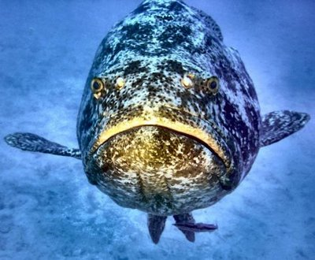
It is a considerable weight and it makes a grunting sound as it hangs alongside the boat ‘He hung a grunting weight’.
Considering it is such a large fish, the poet is surprised that ‘He didn’t fight/He hadn’t fought at all’. The fish submitted.
The focus shifts with the second sentence from Bishop to the fish, from fisher to the item caught.

Slide 4
The Fish’s Appearance
The fish is ‘grunting’, ugly ‘homely’ and worn or damaged ‘battered’ in appearance. These words capture the exhausted and ugly state of the fish.
However, the word ‘venerable’ casts a different light as it may mean aged looking and worthy of reverence.
It’s skin is brown and it hangs off him ‘in strips’, much like strips of ancient wallpaper.

Slide 5
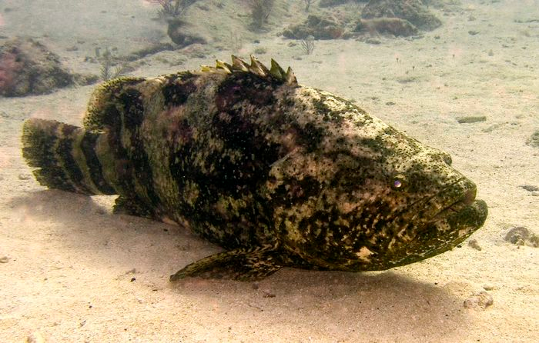
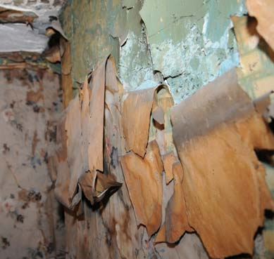
Line 9 begins a thorough investigation and observation of the fish
`There are also ‘darker brown’ patterns on the fish, similar to patterns on wallpaper that have become ‘stained’ and faded over time ‘shapes like full-blown roses/stained and lost through age’. The simile used here is a beautiful image even if the shapes of the fish are lost through age.

Slide 6
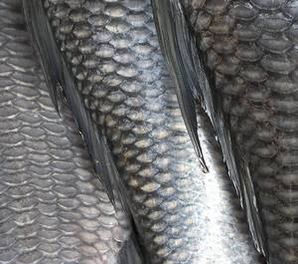
The fish intrigues Bishop, it fascinates and frightens her, teaching her something about the fish and something about herself.
A less attractive aspect of the fish is revealed and we are told that it is ‘speckled with barnacles’, small shelled creatures that have attached themselves to the fish’s body. These barnacles form white, rose shaped patterns ‘fine rosettes of lime’.
The fish’s skin is also ‘infested with sea-lice’.
The colours lime, white and green vividly help to create the complete picture.

Slide 7
The movement of the fish’s gills draws the poets attention to the fact that the fish is out of his natural environment and that the air he breathes is ‘terrible oxygen’ to him. He will die if its gills drink in the air.
The sharp blood-filled gills are ‘frightening’ to the poet and she thinks how they ‘can cut so badly’. While the fish is breathing in the terrible oxygen, the poet imagines an aspect of the fish invisible to the naked eye, its internals.

Slide 8
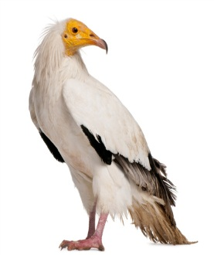
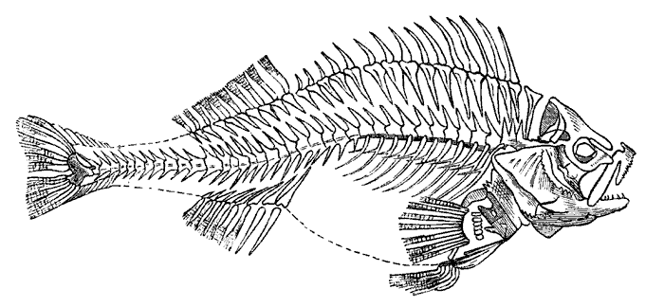
She thinks of:
The ‘course white flesh’ and how it is tightly ‘packed in’ and overlapped like a bird’s plummage ‘like feathers’.
She thinks of the fish’s ‘big bones and the little bones’.
She imagines the ‘dramatic reds and blacks/of his shiny entrails’.
Guts
The image of the feathers, the use of ‘little’, the colours red, black and pink signal Bishops sympathetic imaginative response.

Slide 9
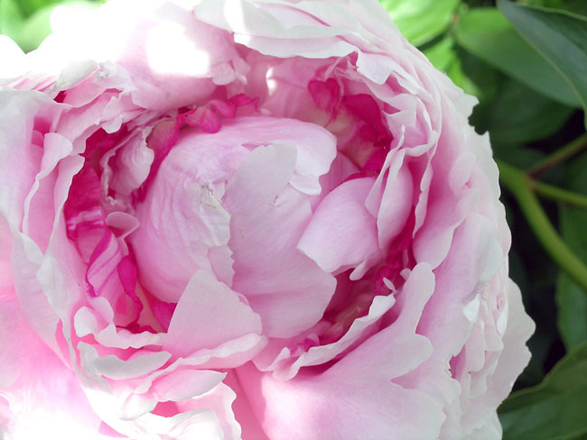
The ‘big peony’ is both a startling and beautiful image. The guts of a fish are usually not viewed in this delicate and imaginative manner. It brings us back to line 14, where the fish's skin was also described in terms of flower imagery – the shapes of full blown roses. This fish is only ugly to the careless observer. Bishop has recognised its beauty.

Slide 10
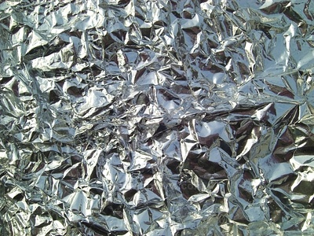
Bishop tells us that she ‘looked into his eyes’ – A relationship is established between the two – captor looking into the eyes of the captive.
First, the fish’s eyes are described in terms of size, shape and colour ‘his eyes which were far larger than mine but shallower, and yellower.
Then they are given more detailed imagery, the irises are ‘backed and packed with tarnished tinfoil’ - It is as if there is dulled tinfoil packed in around and behind the irises.
As the poet stared at the fish’s eyes, they ‘shifted a little’ but they do not move to look at her. It is as if the eyes are drawn towards the light. This suggests the independence, the dignity and yet the vulnerability of the fish.
The lenses covering the eye look like they are made from ‘isinglass’ that has been ‘scratched’.
‘Isinglass’ is a transparent, almost pure gelatin prepared from the inner membrane of the swim bladder of fishes. It is used as an adhesive.

Slide 11
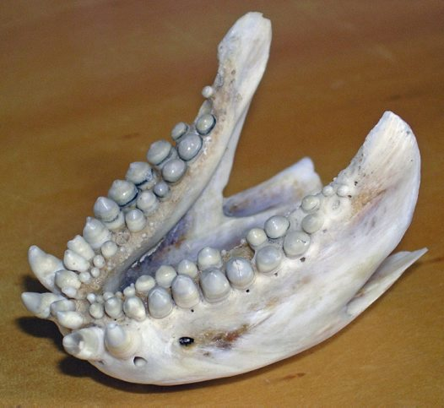
The poet admires the structure and arrangement of the parts of the fish’s jaw ‘the mechanism of his jaw’. The fish’s ‘lower lip’ is ‘wet, grim and weaponlike’.

Slide 12
The five hooks in the fish’s jaw
While she is examining the fish’s jaw, she notices there are ‘five big hooks’ lodged firmly in the fishes ‘lower lip’. These hooks have been lodged there for some time and have ‘grown firmly into his mouth’. Attached to the hooks are pieces of line and wire that would have once connected the hooks to the rod. The hooks with their ragged lines and wire are like ‘medals with their ribbons/frayed and wavering’. The five threads that hang from the hooks resemble ‘a five-haired beard of wisdom/trailing from his aching jaw’.

Slide 13
The
Seeing the hooks in the fish’s jaw has a profound effect on the poet as she realises she is looking at something remarkable. This fish has been caught five times but each time it fought and won its freedom.
She stares and stares at the fish and gets an overwhelming sense of ‘victory’. The world around her is transformed.

Slide 14
This sense that something marvellous has just occurred is heightened by the colours that surround the poet on the boat.
Oil has seeped into the pool of ‘bilge’ that lies at the bottom of the boat and this has created a multi-coloured effect around the engine of the boat that resembles a rainbow.
The poet says that the ‘oil had spread a rainbow/around the rusted engine’. The ‘rusted engine’ and the ‘bailer rusted orange’ add to the vivid colours that surround the poet.

Slide 15
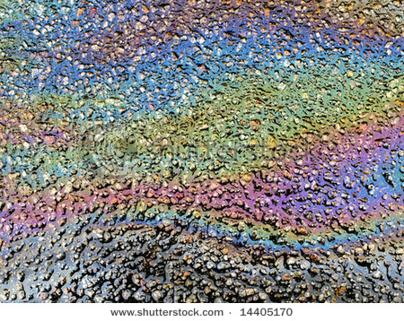
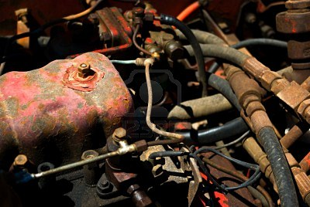
Can you clearly picture the similarities between these pictures?
Vivid colours/multi-coloured effect.

Slide 16
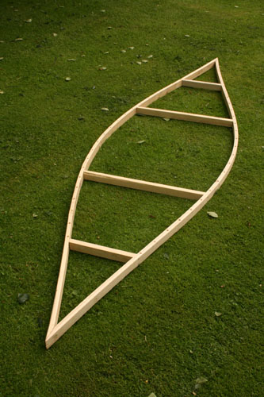
For a brief moment, everything around the poet seems joyous and beautiful ‘everything/was rainbow, rainbow, rainbow!’. The little boat that she sits in is old, worn and dirty. The boat’s engine and bailer are rusty and the ‘thwarts’ are dry and cracked from the sun.

Slide 17
However, this fish has momentarily transformed the space and all is seen in a new and wonderful light.
The poets intentions are never made clear but having seen how it fought for freedom and won five times, she decides that she will release it ‘And I let the fish go’.

Slide 18
CLICK HERE

