Slide 1
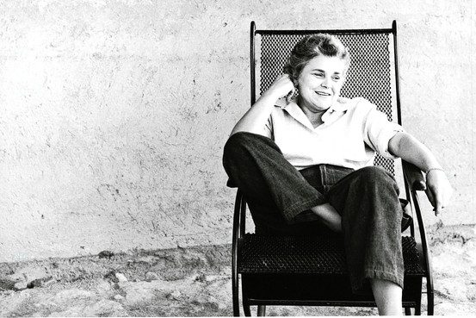
The Prodigal
Elizabeth Bishop

Slide 3
Stanza 1
Bishop often felt like an outsider, someone away from home and like the prodigal son of the poem, she also suffered from drinking bouts.
This poem describes an alcoholic farm labourer who not only works in but sleeps in a pigsty. He is employed in a farm that is a long way from home. He is a voluntary ‘exile’ who would rather work in the pigsty than return to where he came from.

Slide 4
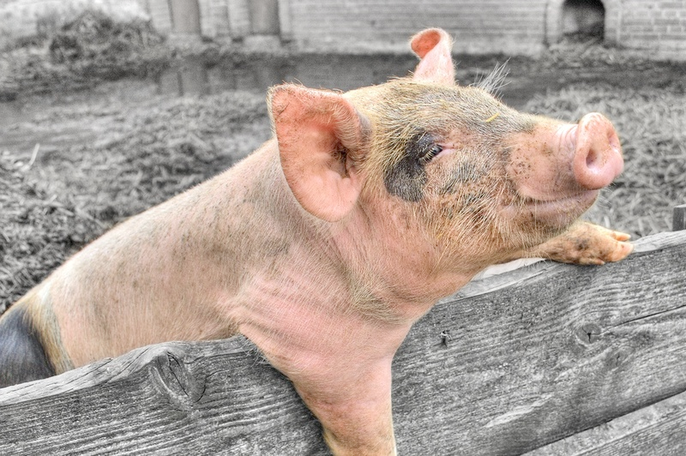
The pig sty can only be described as unpleasant:
The floor is ‘rotten’.
The walls are covered with dung: ‘The sty was plastered halfway up with glass-smooth dung’.
One female pig consistently devours her own children: ‘the sow that always ate her young’.
It has been suggested that there is something unpleasant, even sinister about the way the pigs eyes follow the prodigal around the barn: ‘the pigs’ eyes followed him, a cheerful stare’.
The foul stench of the place closes in around the prodigal in a way that is swamping and claustrophobic.

Slide 5
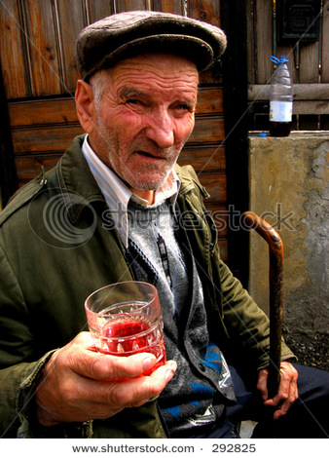
The odour has so overpowered the prodigal’s sense of smell that he can no longer ‘judge’ it: he no longer notices its foulness. It ‘was too close….for him to judge’. Unsurprisingly, the prodigal finds himself disgusted or ‘sickening’ in this foul environment. The colour ‘brown’ captures the impact of the stench.
Like many alcoholics, the prodigal is secretive about his drinking, hiding pint bottles of rum or whiskey behind the pigsty’s planks of wood: ‘he hid the pints behind a two-by-four.’ It would appear he often gets drunk early in the morning ‘sometimes mornings after drinking bouts.’

Slide 6
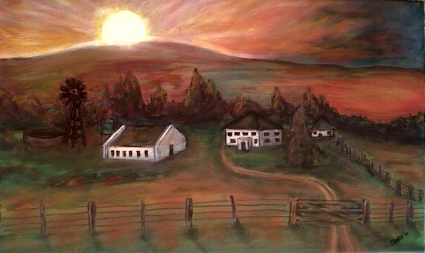
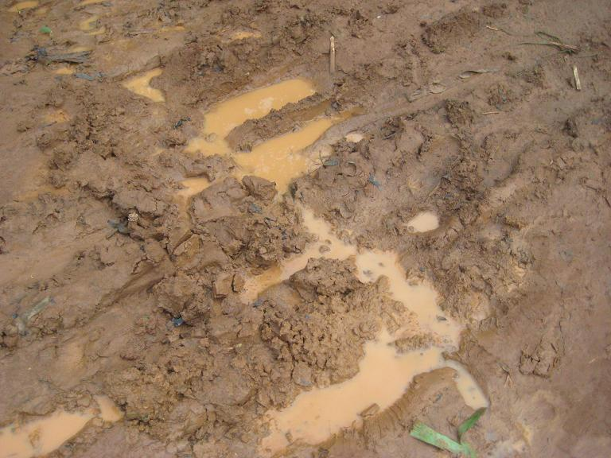
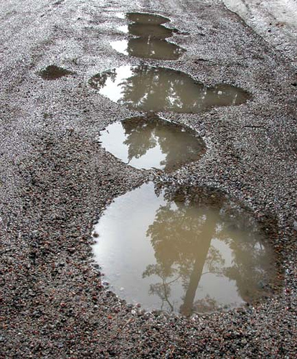
On such mornings, he watches the sunrise in a drunken state, struck by the beauty it brings to the farmyard. The mud and puddles of the yard reflect the colour of the sunrise. The puddle seems to ‘burn’ and the mud is described as being ‘glazed’ with red.
This beautiful sight seems to ‘reassure’ the prodigal, making him feel his life in the barn is worth living.; ‘the burning puddles seemed to reassure’. During these moments, he feels he can continue to put up with the filth and squalor of the pigsty for at least another year rather than returning home to where he came from: ‘And then he thought he might almost endure/his exile yet another year or more’.

Slide 7
Stanza 2
This stanza describes an evening in the farmyard. It is getting dark. The sun is ‘going away’ and the ‘first star’ has appeared in the sky. The prodigal has completed the last tasks of the day ‘carrying a bucket along a slimy board’. His employer ‘shuts the cows and horses in the barn’ and returns to his farmhouse by the light of his lantern. As he walks away, his lantern casts an ‘aureole’ or halo of light, upon the farmyard’s mud. It seems to ‘pace’ along with him as he returns to the farmhouse: ‘The lantern – like the sun, going away - / Laid on the mud a pacing aureole’.

Slide 8
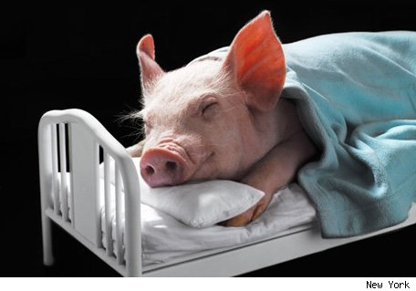
If the prodigal’s mornings are sometimes filled with hope, his nights seem to be miserable. He views the ‘first star’ as a warning to him that night is on the way. We imagine his nights are filled with guilt and self-loathing by his addiction and also due to the fact that he ended up living in such a squalid environment.
His circumstances are contrasted to those of the farmer and the farm animals. Every evening, the cows are ‘shut up’ snugly in their barns, ‘safe and companionable’ as the animals in Noah’s ark. The pigs also snore contentedly; ‘the pigs stuck out their little feet and snored’.

Slide 9
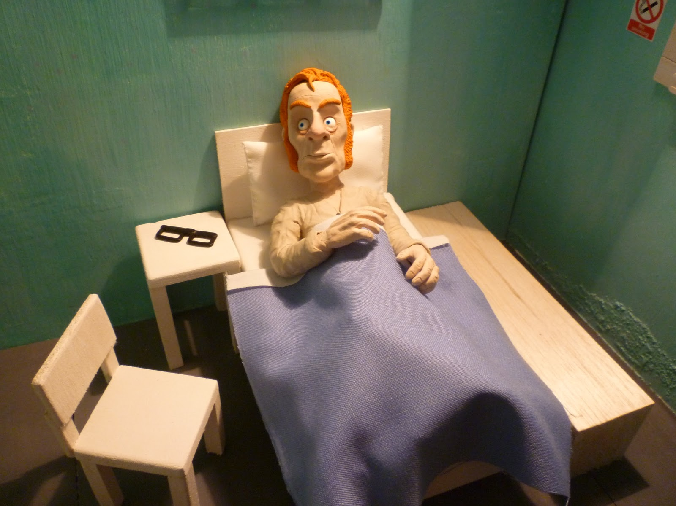
The Farmer
After seeing the cows and horses, the farmer returns to the warmth and comfort of his farmhouse.
Farmer/Farm Animals
CONTRAST
The Prodigal

Slide 10
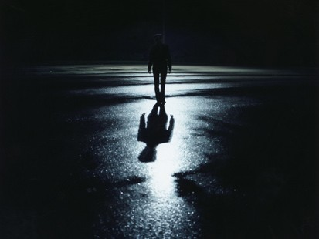
The image of the farmer’s lantern receding into the distance is almost unbearably sad. These lines emphasise the intense loneliness of the prodigal’s night. On evenings like this, as darkness is drawing in and he prepares for another night alone in the barn, the prodigal’s mind is struck by moments of insight ‘He felt …….shuddering insights, beyond his control,/touching him’. He becomes aware of the full grimness of his situation and shudders in horror at the awfulness of his life in the pigsty.
These moments are horrified insights which are ‘beyond his control’. He may find these thoughts unpleasant and unwelcoming but there is nothing he can do to avoid them. He cannot fend them off with drink or with reassuring thoughts about the sunrise.

Slide 11
The ‘shuddering insight’ seems related to the prodigal’s awareness of the bats that fly above the barn ‘he felt the bats’ uncertain staggering flight. It has been suggested that these bats flying blindly through the night serve as a metaphor for the prodigal’s situation. Just as they stumble and fumble through the air, the prodigal staggers and lurches through life, uncertain of how he should live.
The bats, though blind, possess a ‘homing instinct’ that allows them to navigate safely. The prodigal also possesses a ‘homing instinct’, some inner drive or intuition that will eventually cause him to leave the pigsty and return home, to his father’s house.

Slide 12
However, these moments of ‘shuddering insight’ do not cause the prodigal to immediately change his life. Although he realises the misery of his situation, it is a long time before he can find it in himself to leave the pigsty behind and return home ‘But it took him a long time/finally to make up his mind to go home’.

